Slide 1


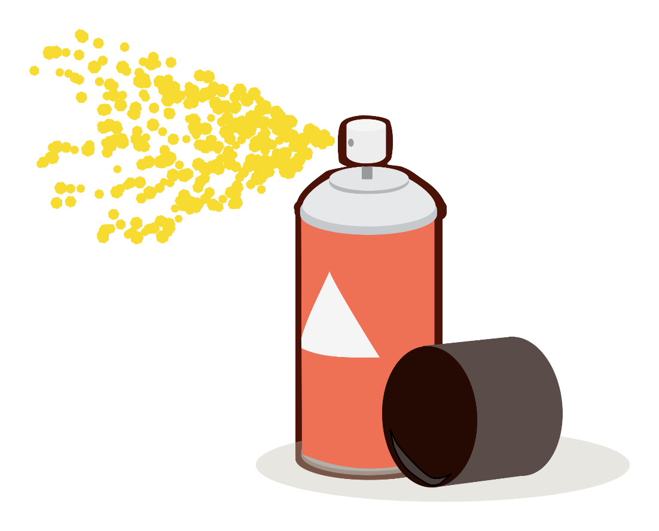
Bergen County Department of Health Presents:
Adults
Notes:
Welcome! I’m from the Bergen County Health Department and we’re here to introduce our Zika campaign, Bergen Bites Back. Our current focus is on Zika. We’ve heard all about it on the news. Please leave your questions at the end.
INSTRUCTOR NOTE: Estimated time (40 minutes).

Slide 2
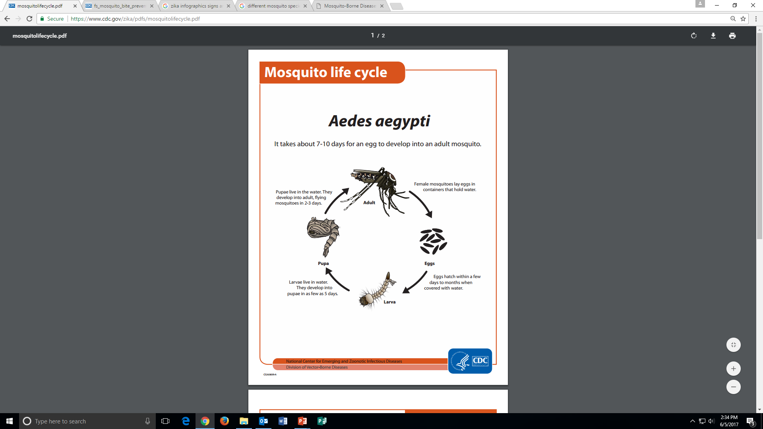
Water + 7 days= MOSQUITOS!
Source: https://www.cdc.gov/zika/pdfs/mosquitolifecycle.pdf
Notes:
How do people contract Zika? and How is Zika spread?
In New Jersey, there are over 60 species of mosquitos.
It does not take much for a mosquito to grow. All they need is water + 7 days + sugar source + suitable source.

Slide 3
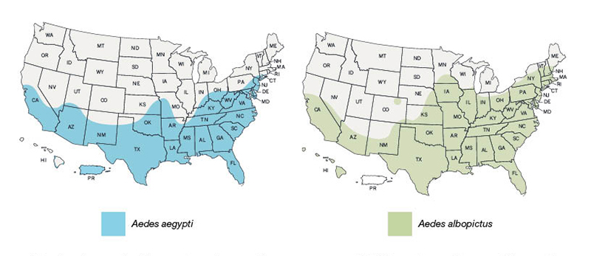
Aedes aegypti vs. Aedes albopictus
They like tropical and warmer climates.
**Main animal responsible for the spread of Dengue, Chikungunya, and others.
They like to be around people so they live near them to feed on them.
They are more likely to spread viruses than other kinds of mosquitos.
They like the tropical areas but they can live in places with changing temperatures.
They don’t just feed on humans but animals as well so they aren’t as likely as the other mosquito to spread viruses.
Source: https://www.cdc.gov/zika/vector/range.html
Notes:
How do people contract Zika? And How is Zika spread?
These maps do not show: the exact number of mosquitos, the exact location, and how likely these mosquitos will spread viruses.
The mosquito type on the left is the “aggressive biter” that I had mentioned previously,
NJ is located in both regions where these two types of mosquitos are present.

Slide 4

West Nile Virus
West Nile Virus is much more prevalent in the U.S. than anywhere else around the world.
It is also spread by infected mosquitos
Most cases are from June-September.
Signs and Symptoms
  Febrile illness
  Encephalitis (inflammation of the brain)
  Meningitis (inflammation of the lining of the brain and spinal cord)
  Majority of people (70-80%) don’t experience symptoms.
First detected in North America- 1999 now has spread throughout the rest of the U.S. and Canada. There are cases from all 48 lower states.
How do people get it?
  Blood transfusions
  Organ transplants
  Exposure in a laboratory setting
  From mother to baby during pregnancy, delivery, or breastfeeding
Incubation period 2-6 days but can go from 2-14 days. It can be longer for people who have other medical conditions affecting the immune system.
All ages groups are at risk but those over 60 years old are at greatest risk.
Has been detected in a variety of species of birds.
No evidence of any cases of people getting sick while handling a live or dead infected bird.
Notes:
West Nile Virus is much more prevalent in the U.S. than anywhere else around the world.
It is also spread by infected mosquitos
Most cases are from June-September.
Signs and Symptoms
Febrile illness
Encephalitis (inflammation of the brain)
Meningitis (inflammation of the lining of the brain and spinal cord)
Majority of people (70-80%) don’t experience symptoms.
First detected in North America- 1999 now has spread throughout the rest of the U.S. and Canada. There are cases from all 48 lower states.
How do people get it?
Blood transfusions
Organ transplants
Exposure in a laboratory setting
From mother to baby during pregnancy, delivery, or breastfeeding
Incubation period 2-6 days but can go from 2-14 days. It can be longer for people who have other medical conditions affecting the immune system.
All ages groups are at risk but those over 60 years old are at greatest risk.
Has been detected in a variety of species of birds.
No evidence of any cases of people getting sick while handling a live or dead infected bird.

Slide 5
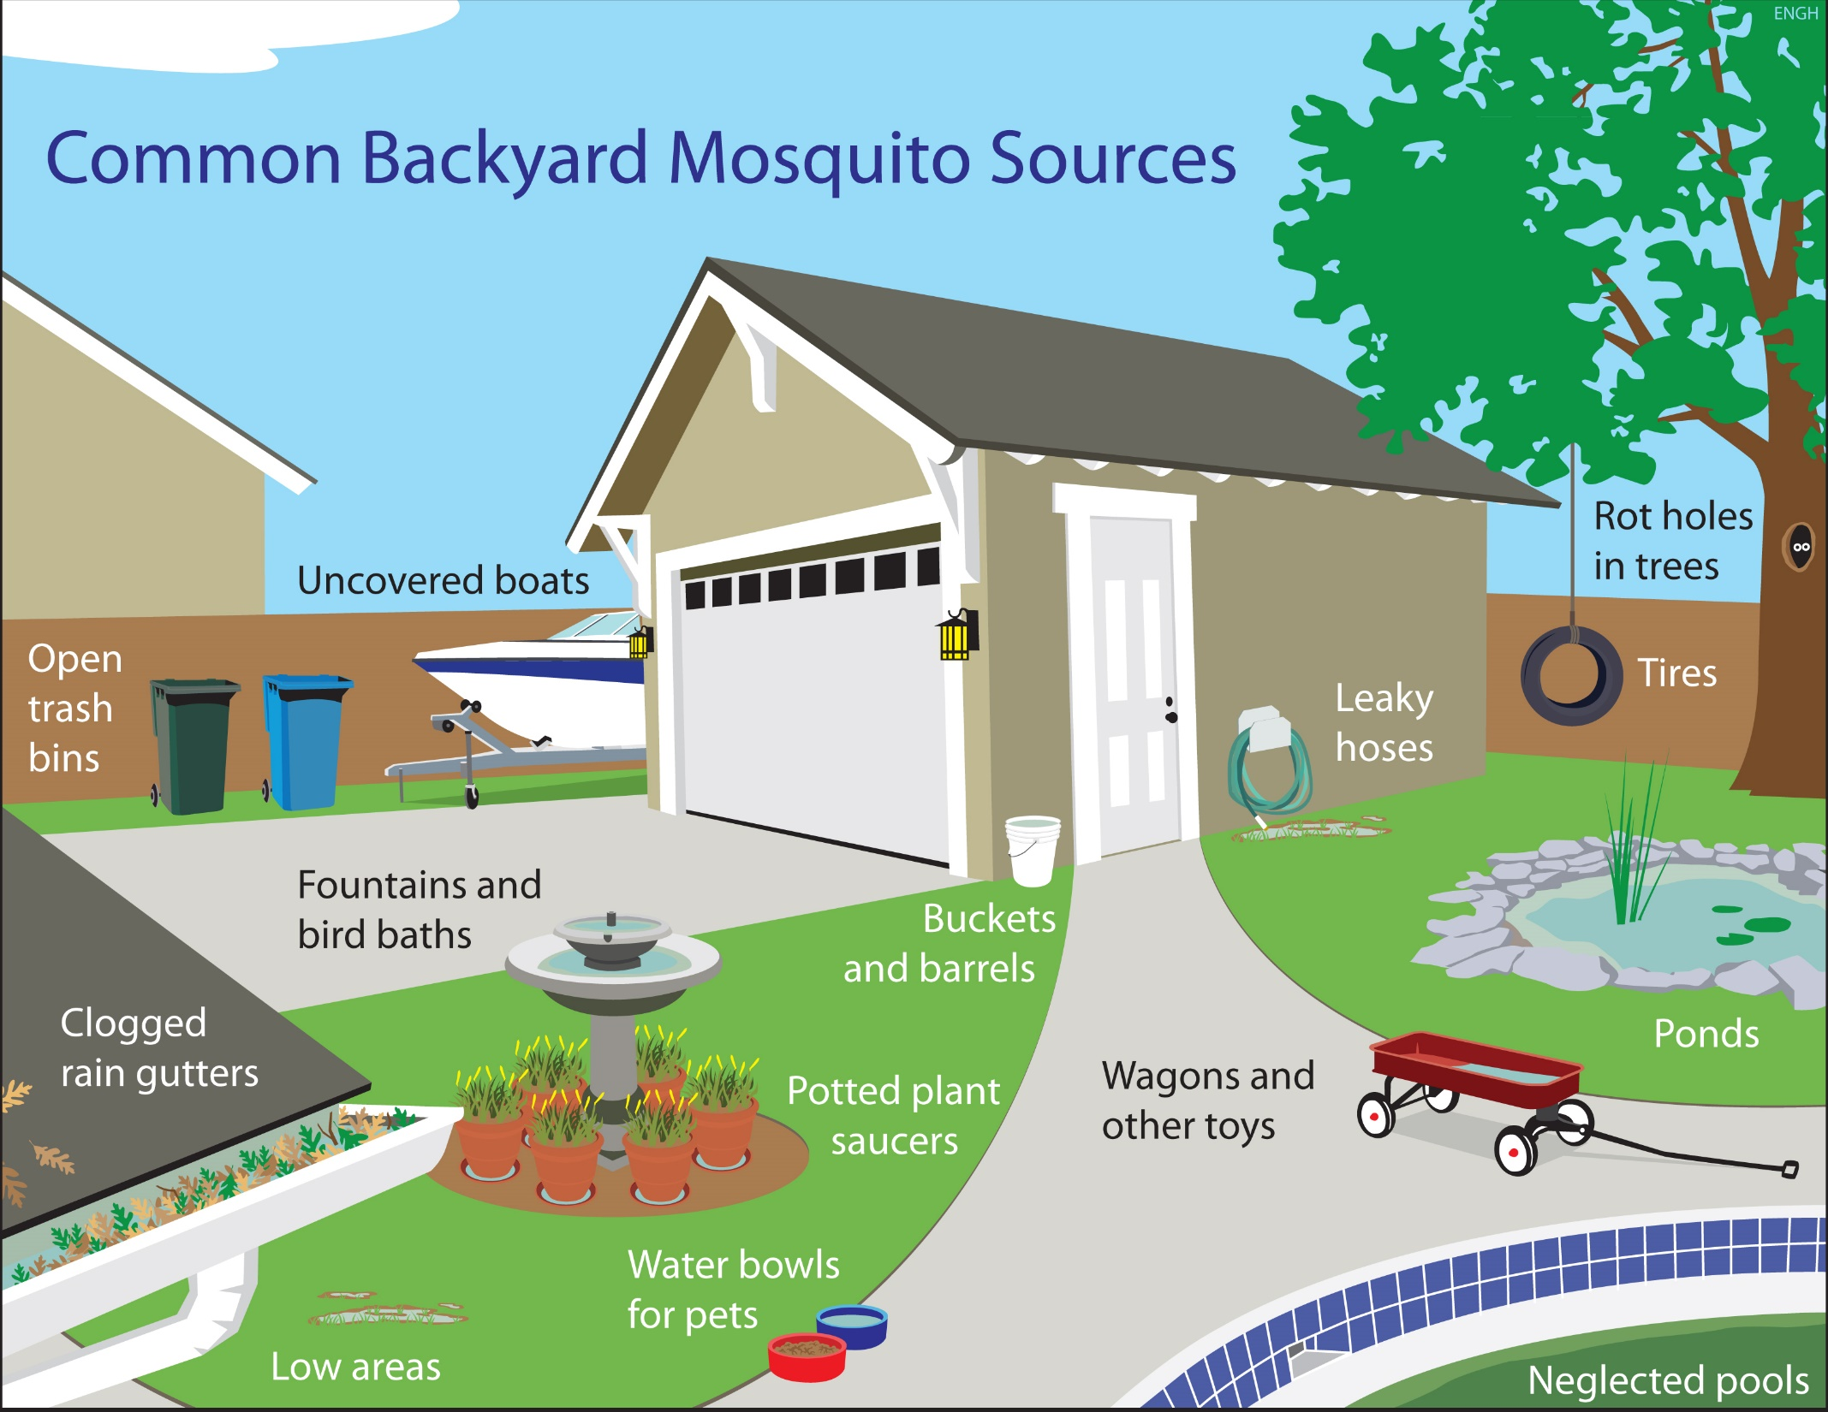
Mosquito Hotspots
Notes:
How is Zika spread?
These pictures show us areas around our homes that can potentially collect standing water and possible breeding grounds for mosquitos.
Do any of these locations surprise you?
One of the top ways to protect ourselves at home is to prevent any breeding sources. It is important to make a habit of frequently checking these spots. Empty or cover any pools of water. There are larvicides you are able to purchase if you are unable to empty or cover these areas or if you’ve already noticed larvae.
INSTRUCTOR NOTE: Name each location.

Slide 6
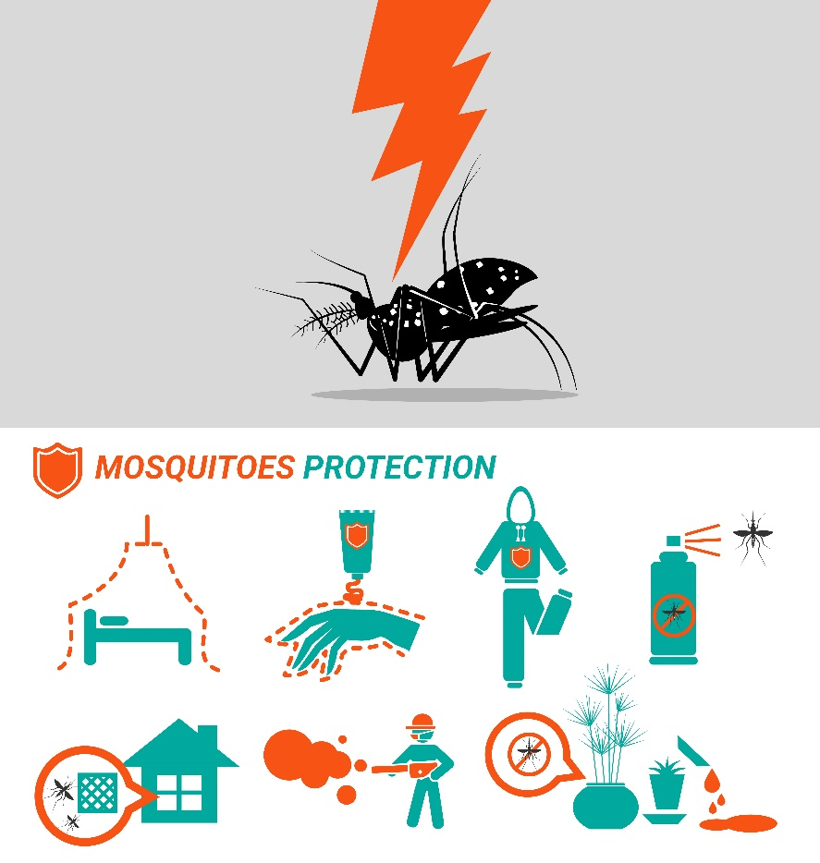
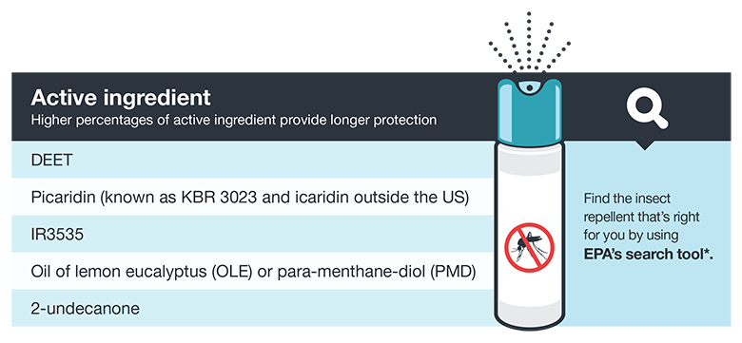
Prevention
Empty any containers of water.
Wear long-sleeved shirts and long pants.
Screens and Nets
In order for the mosquito repellant to be effective it must contain (1) of these active ingredients:
Sources: https://www.cdc.gov/zika/about/overview.html, http://www.nj.gov/health/cd/zika/documents/zika_virus_brochure.pdf https://www.cdc.gov/zika/prevention/prevent-mosquito-bites.html
Notes:
Here’s a quick way to remember how to combat the Zika Virus.
3 D’s: Drain, Dress, and Defend.
It may seem odd to be wearing clothes that cover our bodies in the heat as oppose to wearing T-shirts and shorts. It is important to remember that this is if weather permits, use your judgement to make this call. If it’s a very hot day it is probably not best to be covered up.
Containers of water include buckets, planters, and old tires. You may also purchase larvicides for large containers of water as long as it is not consumed. These are sources of something called STANDING WATER.
As much as possible stay indoors with the windows closed. If the windows or doors need to be opened repair/ install a screen to prevent anything insects from entering the home. There is netting that you can install around your bed as well.
In order for the insect repellant to be effective, the DEET percentage should be between 10-30%. As a bonus, you’re also protecting yourself against ticks.
Please be mindful of the age of your child. You should not put repellant on a baby 2 months and younger. The oil mentioned should not be used on children younger than 3 years old.
INSTRUCTOR NOTE: It is important to note that DEET decreases the effectiveness of SPF. Apply SPF before the insect repellant. Reapply based on the instructions on the label.

Slide 7
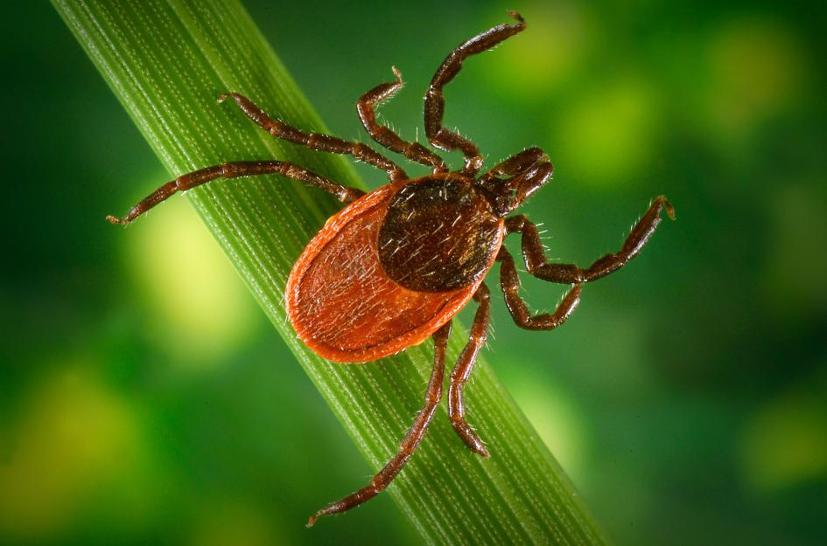
Which tick-borne diseases should we be concerned about?
Several diseases can be acquired from the bite of an infected blacklegged (deer) tick:
Lyme Disease
Babesiosis
Anaplasmosis
Borrelia miyamotoi
Powassan Disease
      PHOTOGRAPH BY JIM GATHANY, CDC/PHIL/CORBIS
Source: B.L.A.S.T Program; Ridgefield Health Department
Notes:
There are approximately 20 tick species of major public health or veterinary importance in the United States and over a dozen human tick-borne diseases that affect humans. We know that several disease can be acquired from the bite of an infected blacklegged tick , often referred to as a deer tick. Lyme Disease is still most common, but health departments are monitoring the rise of Babesiosis and Anaplasmosis. Borrelia miyamotoi and Powassan disease are less common, but can have serious health consequences. It is possible to acquire multiple infections from one tick attachment. While there are other types of ticks in our area, which may carry other diseases, the blacklegged ticks and Lyme disease continue to be our greatest health threat.

Slide 8
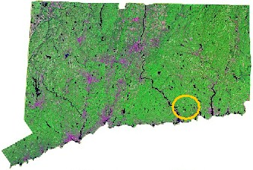


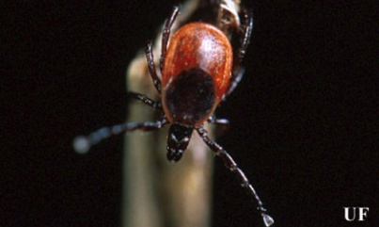
Named after first case in Lyme, CT (1975)
Photograph by Michael Patnaude, University of Florida.
Source: B.L.A.S.T Program; Ridgefield Health Department
Notes:
Lyme disease was first identified in 1975 when a cluster of children and adults residing in the Lyme, Connecticut area experienced uncommon arthritic symptoms. A local mother, Polly Murray, is credited with initiating the medical investigation that resulted in the discovery of this new illness. By 1977, the first 51 cases of Lyme arthritis were described, and the Ixodes scapularis or black-legged tick was linked to the transmission of the disease.

Slide 9
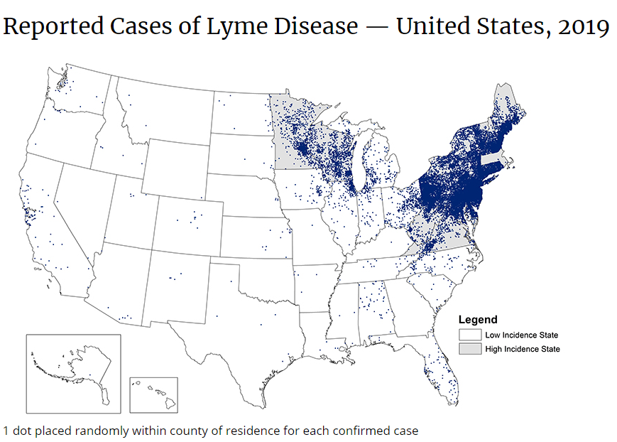
Lyme disease cases 2019
Source: B.L.A.S.T Program; Ridgefield Health Department

Slide 10
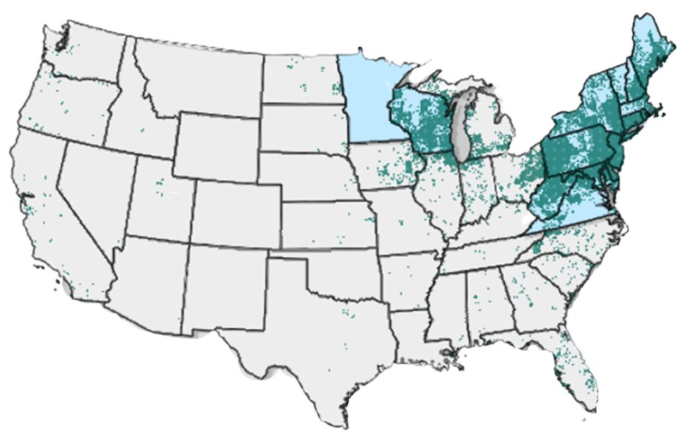
Lyme Disease Cases Over Time by State of Residence- 2020

Slide 11
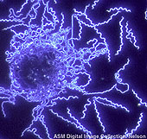
What exactly is Lyme disease?
Lyme disease is a bacterial infection caused by the spirochete
Borrelia burgdorferi.
This organism attacks various organ systems in the body:
  Nervous System
  Activity System
  Circulatory System
Source: B.L.A.S.T Program; Ridgefield Health Department
Notes:
So what exactly is Lyme disease? Lyme disease is a bacterial infection caused by the spirochete Borrelia burgdorferi. This organism attacks various organ systems in the body, including the:
Nervous System (Bell’s palsy, meningitis, jabbing pain)
Activity System (arthritis, migratory, joint pain, swelling)
Circulatory System (heart block, rhythm abnormalities)

Slide 12

Early Lyme disease symptoms
Symptoms typically appear 2-30 days after the bite of
an infected tick.
Early symptoms:
  Expanding "bull's-eye" rash 60%
  Flu-like Symptoms
  Fever
  Malaise
  Fatigue
  Headache
  Muscle aches
  Joint aches
Source: B.L.A.S.T Program; Ridgefield Health Department
Notes:
Lyme disease symptoms are often described as “early” and “late”. Early symptoms typically appear two to 30 days after the bite of an infected tick. The Lyme disease bacterium can infect several parts of the body, producing different symptoms at different times. Not all patients with Lyme disease will have all symptoms, and many of the symptoms can occur with other diseases as well. Early symptoms may include an expanding rash, often presenting as a “bulls-eye”, flu-like symptoms, fever, malaise, fatigue, headaches, muscle aches and joint aches. Individuals who recognize these early symptoms and receive timely treatment often recover without any further complications.

Slide 13
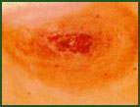
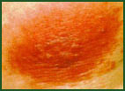

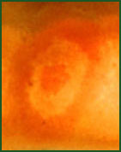
Examples of the “bulls-eye” rash:
L. Zemel
S. Luger
J. Stratton
A. McDonald
Source: B.L.A.S.T Program; Ridgefield Health Department
Notes:
The rash associated with Lyme disease is called erythema migrans or EM. This rash begins at the site of a tick bite after a delay of three to 30 days. A distinctive feature of the rash is that it gradually expands over a period of several days, reaching up to 12 inches across. The center of the rash may clear as it enlarges, resulting in a bull's-eye appearance. But, as you can see in these pictures of EM rashes, the shape can vary. It may be warm but isn’t usually painful. Some patients develop additional EM rashes in other areas of the body. It’s important to know that not everyone with Lyme disease gets a rash. But, when it does appear, the rash is a clear indication of Lyme disease infection and should be shown to a medical practitioner immediately. We suggest taking a picture of the rash for your records.

Slide 14
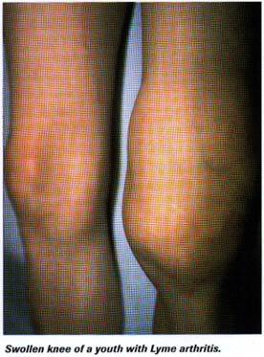
Later signs and symptoms
Severe headaches and neck stiffness
Additional rashes
Arthritis
Facial or Bell's palsy
Intermittent pain
Heart palpitations or an irregular
heart beat (Lyme carditis)
Episodes of dizziness or shortness of breath
Inflammation of the brain and spinal cord
Nerve pain
Shooting pains, numbness, or tingling
Problems with short-term memory
Source: B.L.A.S.T Program; Ridgefield Health Department
Notes:
The “Late” Signs and Symptoms of Lyme disease, which may occur days to months after a tick bite, often include:
Severe headaches and neck stiffness
Additional EM rashes on other areas of the body
Arthritis with severe joint pain and swelling, particularly the knees and other large joints.
Facial or Bell's palsy (loss of muscle tone or droop on one or both sides of the face)
Intermittent pain in tendons, muscles, joints, and bones
Heart palpitations or an irregular heart beat, known as Lyme cardiditis
Episodes of dizziness or shortness of breath
Inflammation of the brain and spinal cord
Nerve pain
Shooting pains, numbness, or tingling in the hands or feet
And problems with short-term memory

Slide 15

How is Lyme disease diagnosed?
Lyme disease is diagnosed based on symptoms, physical findings (e.g., rash), and the possibility of exposure to infected ticks; laboratory testing is helpful if used correctly.
Source: B.L.A.S.T Program; Ridgefield Health Department
Notes:
Unlike many diseases, doctors can’t rely solely on a lab test when making their diagnosis. Lyme disease is diagnosed based on symptoms, physical findings such as the EM rash, and the possibility of exposure to infected ticks. Laboratory testing is helpful when used correctly.

Slide 16
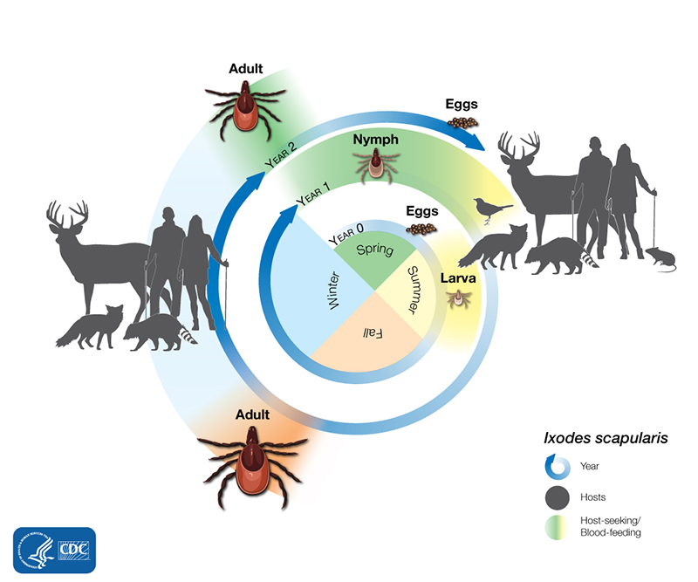
The two year life cycle
Source: CDC
Notes:
Tick eggs hatch in the Spring. The ticks feed three times in their two-year life cycle. Tick larvae feed on mice, moles or birds (known as hosts) in late Summer. Larvae and nymphs can acquire the bacteria which causes Lyme disease when feeding on these infected hosts. The white footed mouse is the principle reservoir for the infection. Nymphal ticks feed in the early Spring, and adult ticks feed and reproduce in the Fall and Winter. Adult female ticks lay approximately 2000 to 3000 eggs per tick in leaf litter in the Spring.

Slide 17
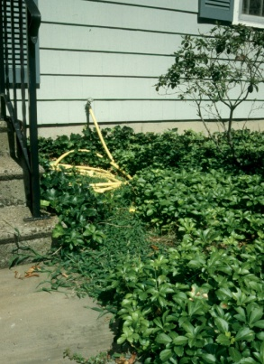


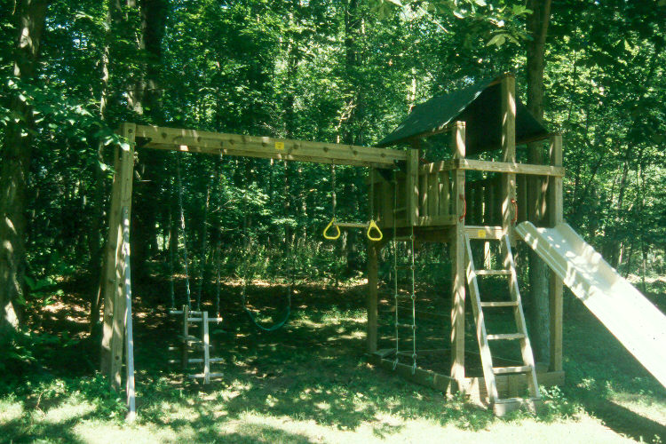


Where do ticks live?
Ticks thrive in shady, moist areas.
Source: B.L.A.S.T Program; Ridgefield Health Department
Notes:
Ticks like damp shady areas under ground covering plants such as pachysandra, myrtle and ivy. They can be found near stone walls. Ticks often hitch a ride on a small rodent such as the white-footed mouse, so you will find ticks in areas that mice find attractive. Dead tree trunks and branches, tall grasses and the wooded edge of your property are also places that you may encounter ticks. Stay away from leaf litter, too. Ticks spend 95% of their life in the leaf litter on the forest floor during their 2 year life cycle! Tick populations can also be abundant in areas where deer live. Deer supply ticks with transportation, a place to mate and a blood meal. Be wary of ticks in places where you see a lot of deer, or deer droppings.

Slide 18
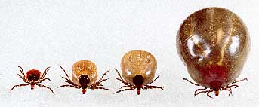
Engorged blacklegged ticks may fool you.
Source: B.L.A.S.T Program; Ridgefield Health Department
Notes:
The term engorged refers to a tick that has fed and is filled with blood. An engorged deer-tick may fool you as they can expand to the size of a small raisin and are often mistaken for dog ticks which do not carry Lyme disease.
The term tick bite may be misleading as ticks do not bite like a mosquito. Ticks attach and feed gradually. Once a tick has found a place to feed, it grasps and begins to cut into the skin. The hypostome penetrates and the tick secretes a “cement” which holds the mouthparts in place while the tick feeds. This cement is one of the reasons ticks may be hard to remove. Irritation may occur at the site of the bite and should not be mistaken for the EM rash.

Slide 19
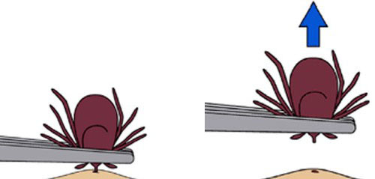
What is the best way to remove a tick?
Use fine-tipped tweezers.
Grasp the tick by the mouthpart close to the skin.
Pull straight back with a slow, steady force.
Avoid crushing the tick’s body.
Place tick in a plastic vial or zip-lock bag for testing.
Wash area and disinfect the bite site.
Record the date and location of the bite.
Watch for early symptoms.
Source: B.L.A.S.T Program; Ridgefield Health Department
Notes:
Remove a tick from your skin as soon as you notice it. Use fine-tipped tweezers to firmly grasp the tick very close to your skin. With a steady motion, pull the tick’s body away from your skin with a slow, steady force. Avoid crushing the tick’s body. If the tick’s mouthparts remain in the skin, don’t be alarmed. They can’t transmit the Lyme disease bacteria once separated from the tick’s body. You’ll want to remove them with the same care you would use for a splinter. Always clean your skin with soap and warm water or alcohol after removing a tick.
Place the tick in a plastic vial or zip-lock bag for identification and testing. Always record the date and location of a tick-attachment on your calendar. Consult with your physician and watch for early symptoms.
You may have heard some recommendations for removing ticks that are not effective and may actually increase the risk of pathogen transmission. Don’t squeeze or rupture the tick. Don’t pour kerosene or nail polish remover on the tick. Don’t rub Vaseline or Petroleum Jelly on the tick. You want to avoid doing anything that might otherwise traumatize the tick. Your goal is to remove the tick swiftly and carefully.

Slide 20
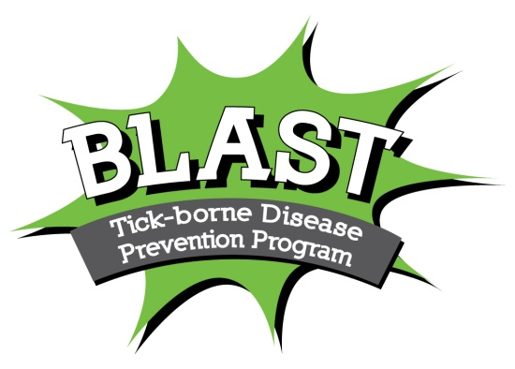
Source: B.L.A.S.T Program; Ridgefield Health Department
Notes:
Bathe or shower soon after coming indoors. Data from a study conducted by the Connecticut Emerging Infections Program at the Yale School of Public Health has shown that people who did not contract Lyme disease were nearly twice as likely to shower or bathe within 2 hours after spending time in their yards. Bathing washes off unattached ticks and provides the perfect opportunity to do a thorough tick check. Ticks may still be on your clothing, so put clothes in a hot dryer for 10 minutes if they’re dry or 50 minutes if they’re wet. Washing clothes alone doesn’t kill ticks.
Look- … reminds everyone to look for ticks and rashes on your body after coming indoors. Finding and removing an attached tick as soon as possible may reduce your risk of getting the disease… so the sooner the better! Check under your arms, in your ears, the belly button, behind your knees and in other places where a tick may go undetected. Ticks are very small, and may feed anywhere on the body so check thoroughly. Tick bites are usually painless. That’s why people are surprised when they find a tick attached to them. Do a tick check every night…and while you’re looking…check for expanding rashes too.
Apply repellents to skin and/or clothing. The CDC recommends using repellents that contain 20% to 30% DEET (N, N-diethyl-m-toluamide) on exposed skin and clothing for protection that lasts up to several hours. Always follow product instructions. Parents should apply this product to their children, avoiding hands, eyes, and mouth.
Another option is to use products that contain permethrin on clothing and gear. Treat shirts, pants, socks and shoes when you are not wearing them. Spray outdoors in a well ventilated area and allow them to dry before putting these items on. Permethrin remains protective through several washings. Pre-treated clothing is available and may provide longer-lasting protection.
Spray- Research has shown spraying for tick control can be very effective. According to the Connecticut Agricultural Experiment Station, a single perimeter spray in the Spring can reduce the number of ticks in your yard by up to 80 – 90%. This should be a high power spray targeting tick habitat areas. Concentrate on:
-The yard perimeter where the lawn meets the wooded edge
-Stonewalls
-dense groundcover plantings
-Several yards into bordering woodlands
You do not need to treat short, well manicured lawn areas that are in full sun. Ticks are found in shady, moist, untended areas. Watch out for leaf litter, wood piles and invasive plants such as Barberry bushes that provide a safe habitat for rodents and the ticks they carry.
Treat- Pets, especially dogs, can be seriously impacted by tick-borne diseases. Unfortunately, vaccines are not available for all the illnesses dogs can get from ticks, and they don’t keep your pet from bringing ticks into the house. For these reasons, it’s important to use a tick prevention product for your dog or cat and to check your pets daily for ticks, especially after coming indoors. Ask your veterinarian about the ticks found in your area, vaccines, topical products, collars, and other prevention methods available. Don’t allow pets to sleep on your bed as ticks may crawl off the dog or cat and on to a family member. Cats are extremely sensitive to a variety of chemicals so don’t apply any insect acaricides or repellents to your cats without first consulting your veterinarian! Tick bites on pets may be hard to detect. Signs of tick-borne disease may not appear for 7-21 days or longer after a tick bite, so watch your dog closely for changes in behavior or appetite if you suspect that your pet has been bitten by a tick. Symptoms may include fever, lack of appetite, lameness and joint swelling.

Slide 21
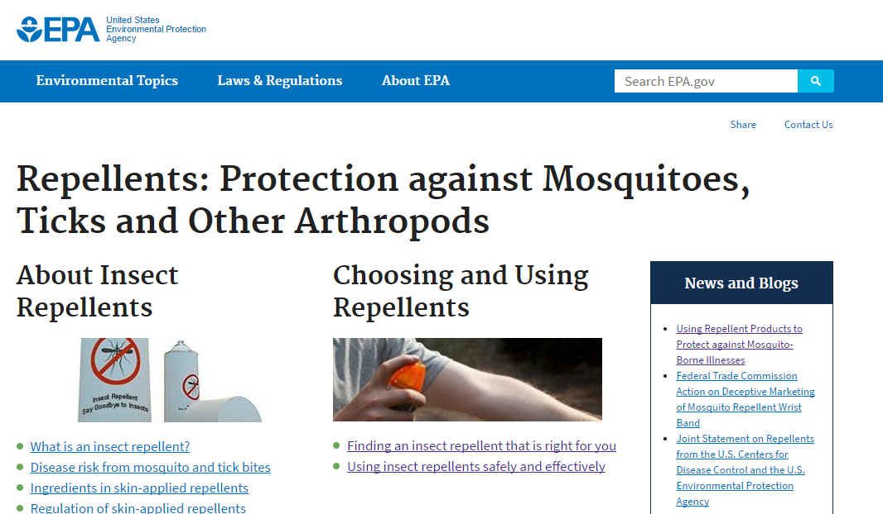
Choosing the Right Insect Repellant
Notes:
This is directly off of the EPA website: https://www.epa.gov/insect-repellents
Questions on the form:
How much time will you need to be protected from biting insects?
Do you need protection from mosquitos, ticks, or both?
You can refine your search by specifying one or more of the following options:
Which product are you interested in? (You can leave this blank to get a list.)
Are you interested in a particular active ingredient?
Are you looking for a specific company name?
Do you know the EPA registration number of the product you are looking for? (You can leave this blank to get a list)

Slide 22
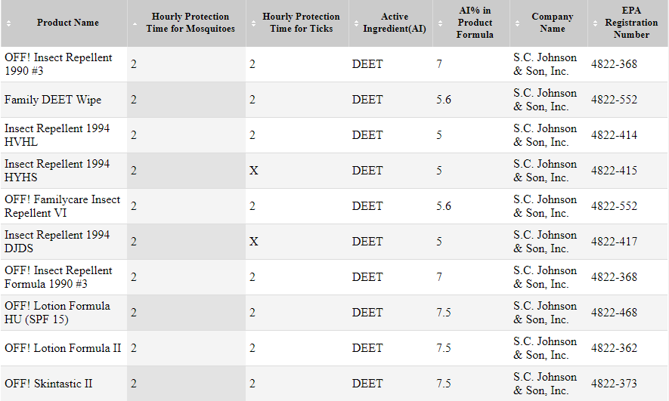
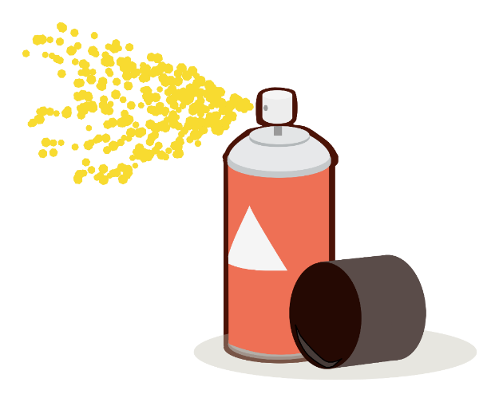
Prevention Methods
Notes:
This is a screen shot of the EPA website.
You can actually look on the EPA website and search for an insect repellant with a specific active ingredient. You can search as broad or specific as you want.
These are a few search results of brands that we may be familiar with.
INSTRUCTOR NOTE: Please discuss what could be found in each column of the graph above.
There are unregistered ingredients such as Peppermint Oil, Soybean Oil that seem to be as effective at DEET but we would recommend that you use products with ingredients that are registered by the EPA.

Slide 23
Which order should I apply sunscreen and insect repellant?
Tips for everyone
Always follow the product label instructions.
Reapply insect repellent as directed.
  Do not spray repellent on the skin under clothing.
  If you are also using sunscreen, apply sunscreen first and insect repellent second.

Slide 24




Resources
Bergen County Division of Mosquito Control
Department of Public Works
220 East Ridgewood Avenue
Paramus, NJ 07652
(201) 634-2880, 2881
Notes:
We’ve added a list of local phone numbers that you can call if you’re concerned about a Zika case.
Although there is a lot of information that we’ve uncovered about Zika, there is still a lot that we don’t know.
There is a list of local travel clinics that offer vaccinations on the following slide.

Slide 25

Bergen County Department of Health Services
One Bergen County Plaza
Hackensack, NJ 07601
(201) 634-2600
Notes:
We’ve reached the conclusion of our PowerPoint presentation. We’re going to open up the floor for questions now.
INSTRUCTOR NOTE: Leave about 20-30 minutes to answer questions.

