Slide 1

Dan Kotkin
11.29.18
Social Security

Slide 2
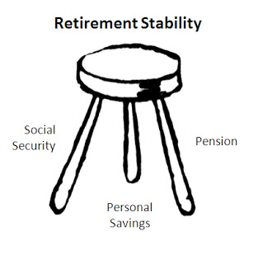
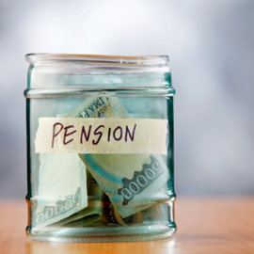

Social Security along with your Pension (PERS) and personal savings can insure that you can retire without worrying about financial insecurity or disaster.
You can access you information online :
https://www.ssa.gov/

Slide 3


Slide 4
Social Security offers an online retirement application that you can
complete in as little as 15 minutes. It's so easy. Better yet, you can
apply from the comfort of your home or office at a time most convenient
for you. There's no need to drive to a local Social Security office or
wait for an appointment with a Social Security representative.
In most cases, once your application is submitted electronically, you're done.
The online application is currently only available in English.
Questions about our Social Security Retirement Benefits Application...
Who can apply for retirement benefits online?
  are at least 61 years and 9 months old;
  are not currently receiving benefits on your own Social Security record;
  have not already applied for retirement benefits; and
  want your benefits to start no more than 4 months in the future. (We cannot process your application if you apply for benefits more than 4 months in advance.)

Slide 5

What about Medicare?
If you already have Medicare, you can still use the online application to apply for retirement benefits.
If you don’t have Medicare but are within 3 months of age 65, you can use this application to apply for:
both retirement and Medicare; or
just Medicare, if you aren't ready to receive retirement benefits yet.

Slide 6
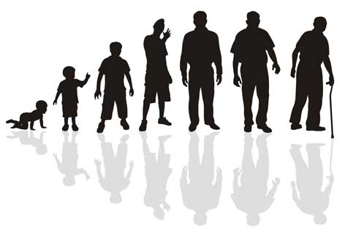
WHAT DO I NEED TO KNOW?
Your "full retirement age" -
  Depending on your date of birth, that may be between age 66 and 67. This could affect the amount of your benefits and when you want the benefits to start.
When you can start benefits -
  You may start receiving benefits as early as age 62 or as late as age 70.
Benefits are reduced for age -
  Your monthly benefits will be reduced if you start them any time before "full retirement age."
If you elect to receive benefits before you reach full retirement age, you should understand how continuing to work can affect your benefits.
Delayed retirement credits may be added to your benefits if they start after your full retirement age.

Slide 7
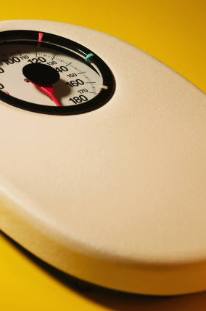



Life Expectancy

Slide 8

Many of us will live much longer than the “average” retiree, and most women live longer than men.
More than one in three 65 year olds today will live to age 90, and more than one in seven will live to age 95.
Social Security benefits, which last as long as you live, provide valuable protection against outliving savings and other sources of retirement income. Again, you’ll want to choose a retirement age based on your circumstances so you’ll have enough income when you need it.
Use the Retirement Estimator to get a personal estimate of how much your benefits will be at different ages and "stop work" dates before you begin the application.

Slide 9
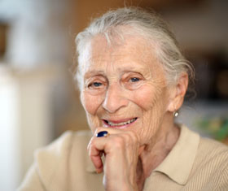

Some of the things you should think about before you decide include:
how long you think you will receive benefits,
  your health &
  whether anyone else in your family can get benefits on your record.

Slide 10
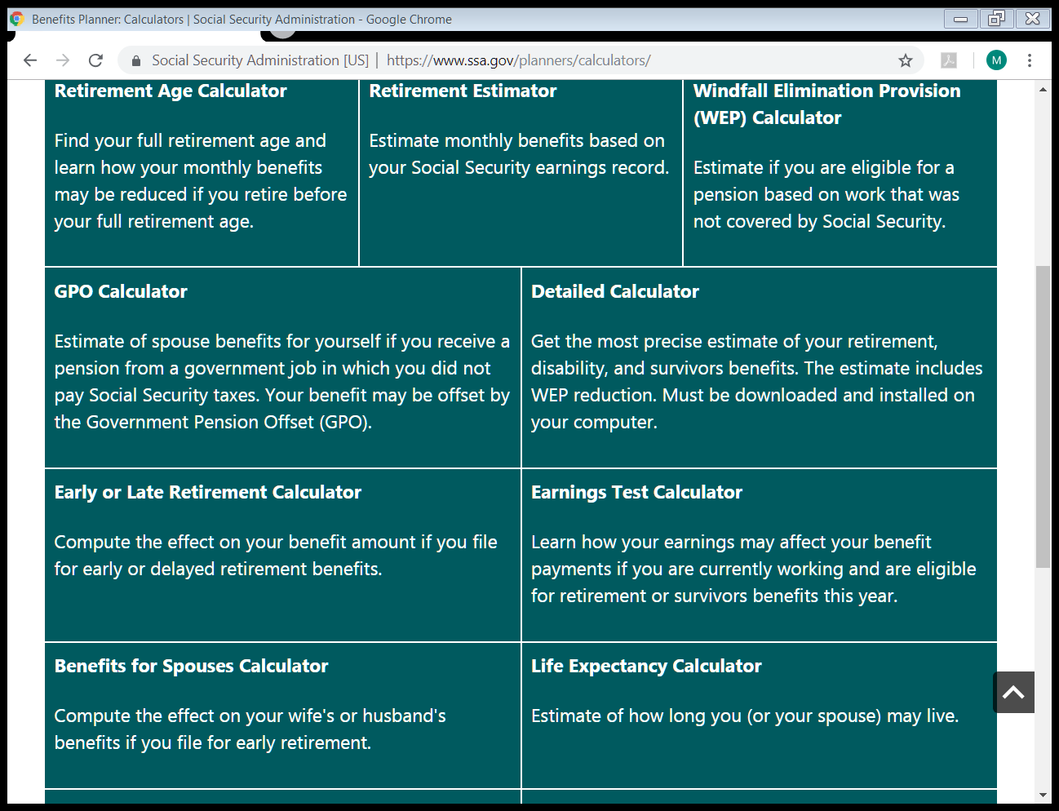

Slide 11
If you were born in 1960 your full retirement age is 67
Remember, the earliest a person can start receiving Social Security retirement benefits will remain age 62.
If you start receiving retirement benefits at:
age 62, you will get 70 percent of the monthly benefit because you will be getting benefits for an additional 60 months.
age 65, you will get 86.7 percent of the monthly benefit because you will be getting benefits for an additional 24 months.
If you start receiving benefits as a spouse at your full retirement age, you will get 50 percent of the monthly benefit your spouse would receive if their benefits started at full retirement age. If you start receiving benefits at:
age 62, you will get 32.5 percent of the monthly benefit instead of 50 percent because you will be getting benefits for an additional 60 months.
age 65, you will get 41.7 percent of the monthly benefit instead of 50 percent because you will be getting benefits for an additional 24 months.

Slide 12
Early Retirement Reductions
Age % % for Spouse
62 70.0% 32.5%
62 + 1 month 70.4 32.7
62 + 2 months 70.8 32.9
62 + 3 months 71.3 33.1
62 + 4 months 71.7 33.3
62 + 5 months 72.1 33.5
62 + 6 months 72.5 33.8
62 + 7 months 72.9 34.0
62 + 8 months 73.3 34.2
62 + 9 months 73.8 34.4
62 + 10 months 74.2 34.6
62 + 11 months 74.6 34.8
And so on and so on ….

Slide 13
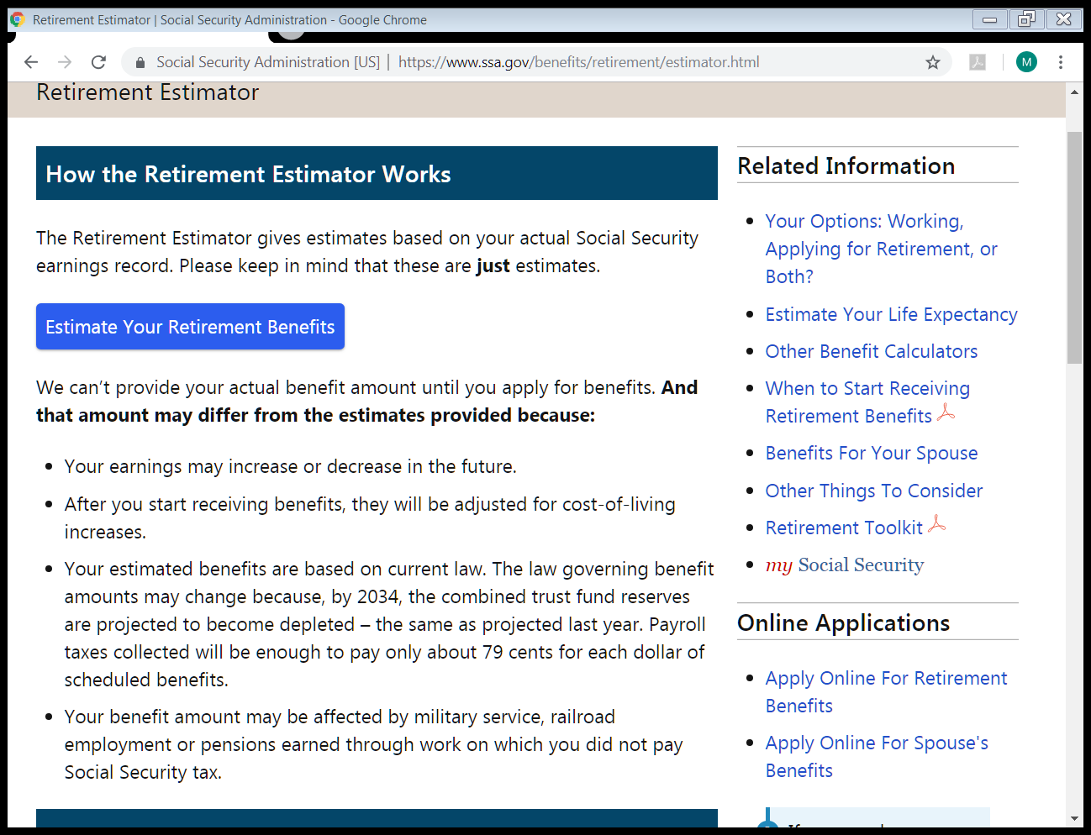

Slide 14
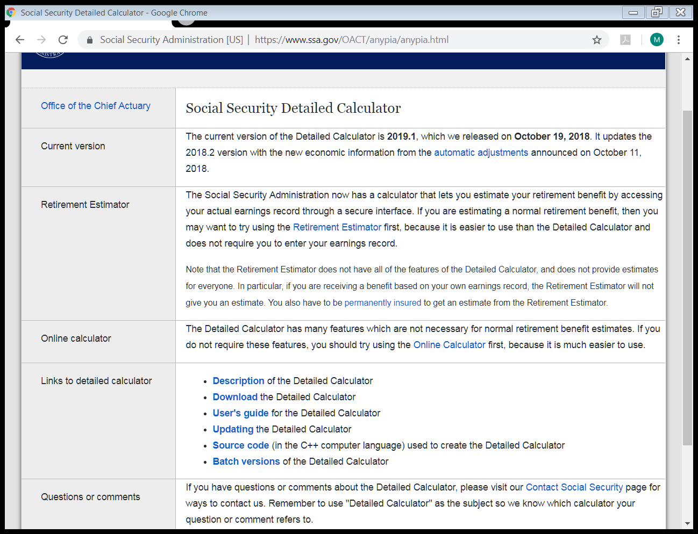

Slide 15
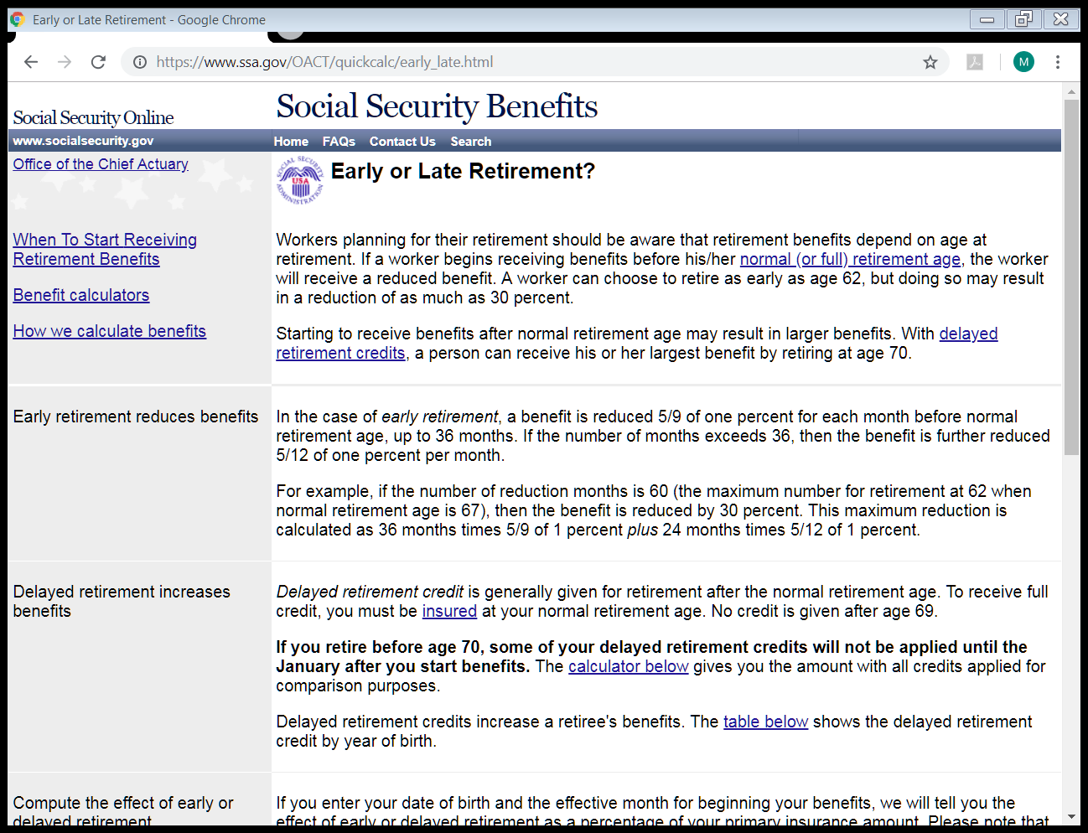

Slide 16
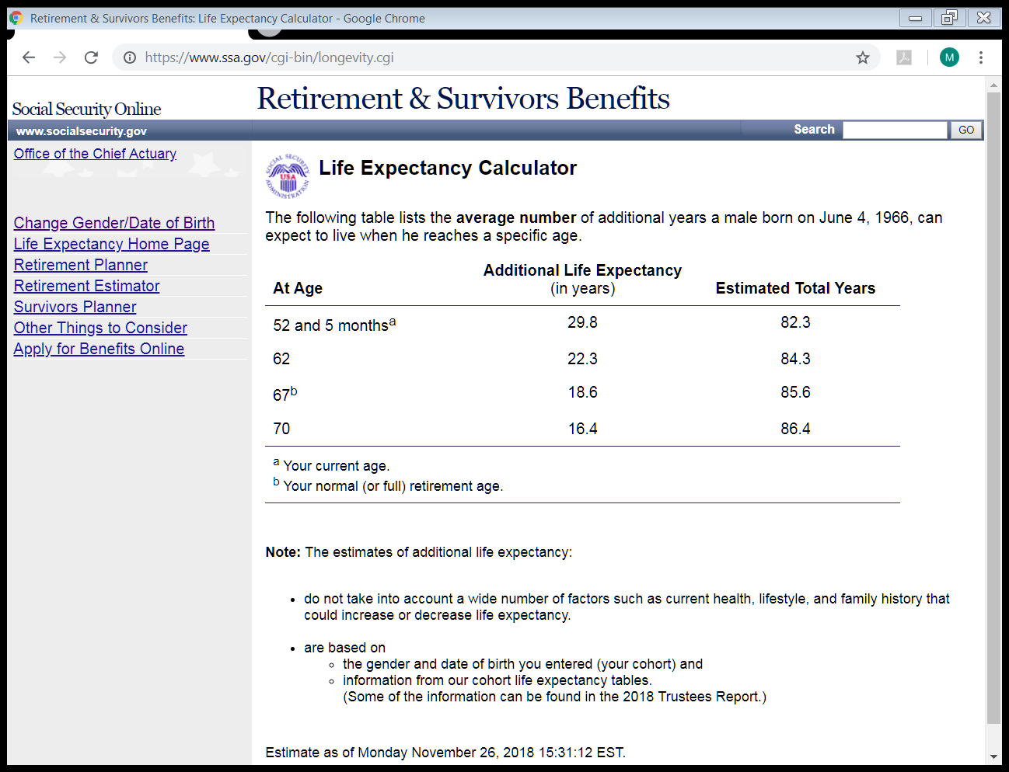

Slide 17
CONTACT SOCIAL SECURITY
By phone - Call 1-800-772-1213. (TTY 1-800-325-0778) from 7 AM to 7 PM Monday through Friday.
In person - Visit your local Social Security office. (Call first to make an appointment.)
If you do not live in the U.S. or one of its territories you can also - Contact the nearest U.S. Social Security office, U.S. Embassy or consulate.

